Slide 1
SCTL55 Smart Configurator
Industry 4.0 in your hands
July 2019

Slide 2
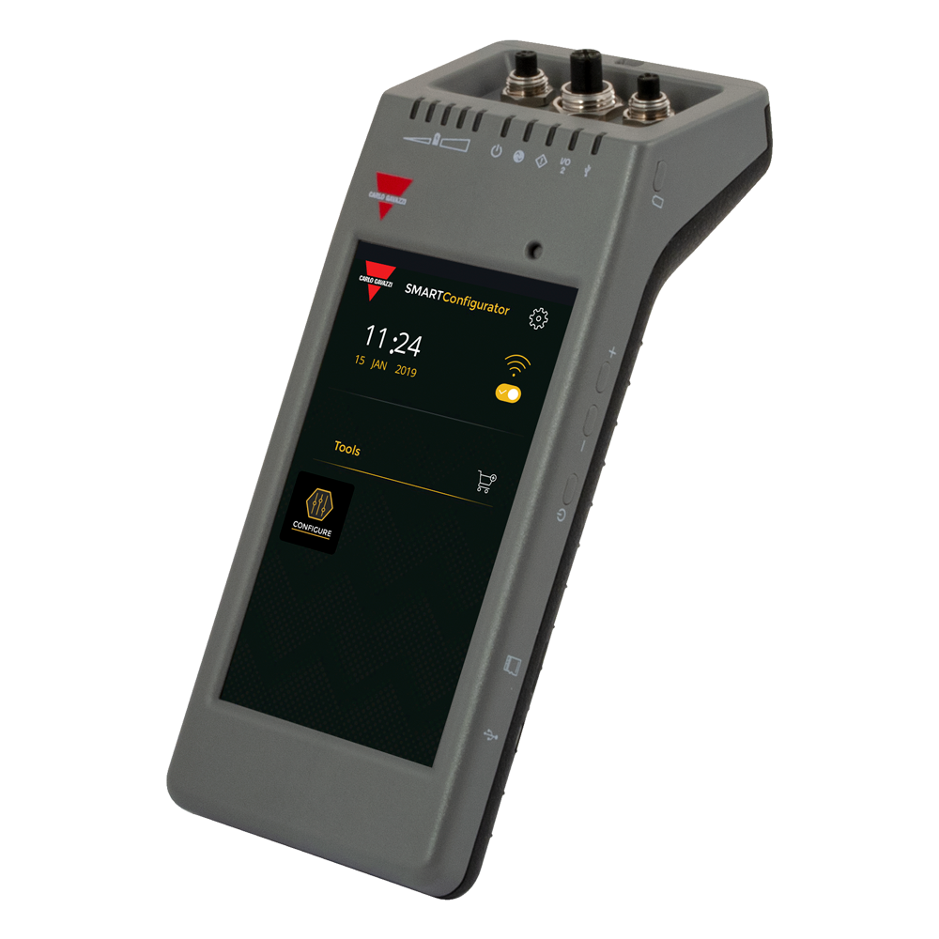
Contents
SCTL55
Smart Configurator

Slide 3
Contents
INTRODUCTION
Basically Technically information
Expectations
Markets of interest
THE PRODUCT
Relevant technical data
Product vs. price positioning
THE MARKET
Relevant applications
Marketing tools
CONCLUSIONS

Slide 4
Introduction
Introduction
Basic Technical information
The SCTL55 Smart Configurator is a portable, self-powered and user-friendly device that allows to configure IO-Link sensors in an extremely easy way and replaces the need to program the sensor via a USB IO-Link Master connected to a PC with a dedicated software or via a network connected master device.
Full mobility, thanks to the rechargeable high capacity battery that lasts more than 5 hours in full operation and more than 22 hours with the screen off. It can be used on the plant floor or in the office without the need for power or a laptop.
Monitor sensor status and diagnostic. Through the 5.5" HD touchscreen display and a dedicated App you can now access to an advanced diagnostic, check operating hours, number of detections, operating cycles, alarms and much more. You can verify your sensor status, including current temperature, quality of run and process data and easily change the operating sensor parameters, such as switch point mode, sensing distance, timing functions, output configuration (PNP/NPN/push-pull, NO/NC), to better meet the process requirements.

Slide 5
Basic Technical information
As soon as you plug the sensor to one of the 3 connectors on the top of the device, if IODD file is not already memorized, the SCTL55 will automatically download it, through Wi-fi and show all sensor’s data in a few seconds.
Thanks to the user friendly GUI, it is so easy for the users to add any parameter to favourite selection on the homepage and create profiles with different levels of accessibility to the sensor’s parameters as observer, maintainer or specialist.

Slide 6
Introduction
Introduction
Expectations
This unique device makes Carlo Gavazzi be recognized as the technological leader in sensor’s diagnostic and programming, with a game-changing new product that nobody else have available in its product range. The new Smart Configurator is a really user friendly, wireless solution that simplifies the configuration, adjustment and diagnosis of an IO-Link sensor, also installed on a machine.
Thanks to this new device we expect Carlo Gavazzi to be recognized as one of the main players in Industry 4.0.

Slide 7
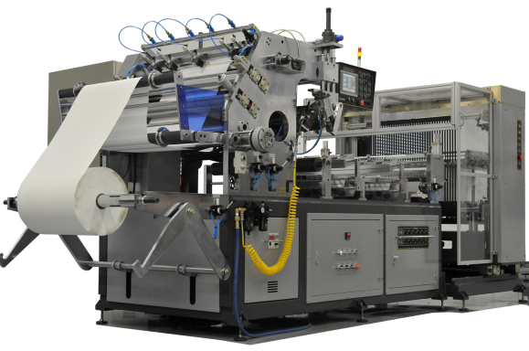
Introduction
Markets of interest
Large Machine and Process
Small and Medium size Machine / Distributors
Simplify system design
Simplify maintenance
Use all IO Link features
Configurable sensor on the machine
Less inventory
Easy to use, flexible and portable

Slide 8
The product
Relevant Technical Data
Type code for standard product
Smart Configurator
Screen size
55: 5.5” HD diplay
S C
T L
55
Display type
T: Touch screen
Type of connectors
L: 1 x M8 3-wire, 1 x M8 4-wire, 1 x M12

Slide 9
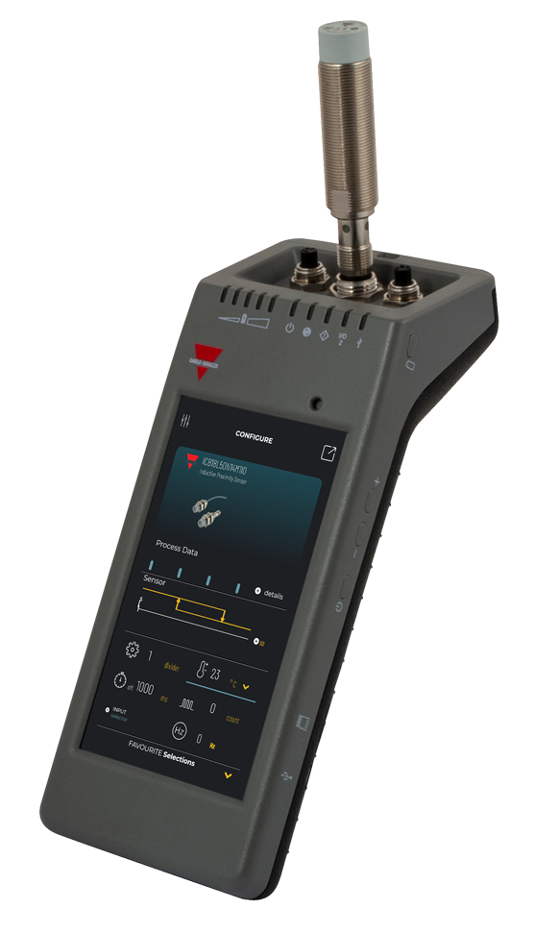
The product
Relevant Technical Data
5.5” HD touch screen display 720 x 1280 pixels
Body in polycarbonate, IP30
Internal memory and microSD card expandable memory
Wi-Fi enabled (b,g,n)
Micro USB port
High capacity rechargeable Li-ion battery
Possibility to recharge the battery with a power bank
LED indicators for the main battery
Lanyard and belt clip for portability
Transportation bag

Slide 10
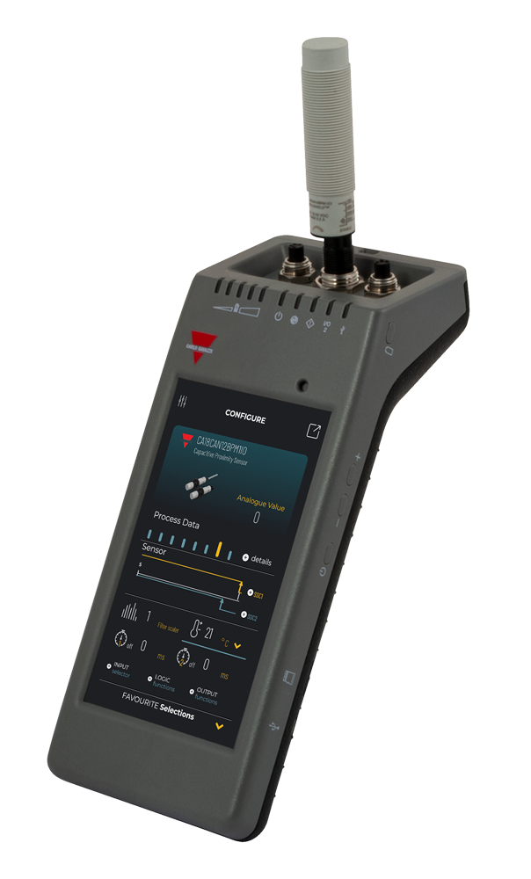
The product
Relevant Technical Data: IO-Link interface
Supply voltage: 24VDC +/- 20%
Max load: 80mA / short circuit protected
SIO2 output test: Led indicated Standard IO 2 logic state (pull down only)
Incorrect polarity protection
Connectors to sensors:
Plug type: M8 3-wire, M8 4-wire, M12
Cable type: connect via accessory (included)
IO-Link protocol support: IO-Link v1.1

Slide 11
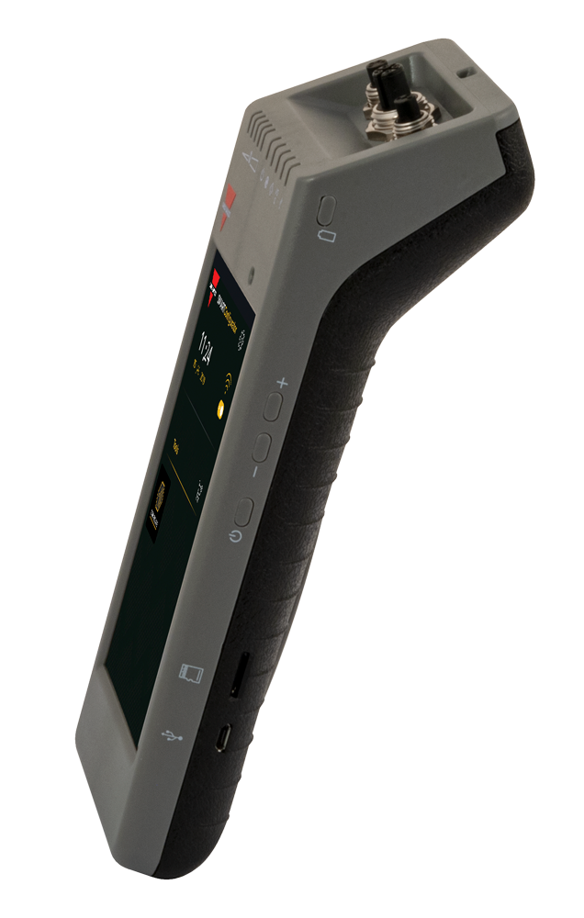
The product
Relevant Technical Data
Carlo Gavazzi launcher homepage and app store
Dimensions (H x L x W): 62 x 222 x 90 mm
Ambient air temperature:
Charging: 10 to +35°C
Operating: 0 to +40°C
Storage temperature: 0 to +50°C

Slide 12
The product
User interface
System and battery LEDs
Short press for main battery status
HD Touch screen display
For future use
Micro SD card port
Power On
Micro USB port

Slide 13
The product
Rechargeable high capacity battery
Operating time:
Full operation: > 5 hours
Screen off: > 22 hours
Standby time:
Device completely off: 6 months
LI-ION Internal batteries:
3.8V / 10Ah (2x3.5Ah + 3Ah)
Charge time:
5V / 1A standard charger via USB mini connector: < 10 hours

Slide 14
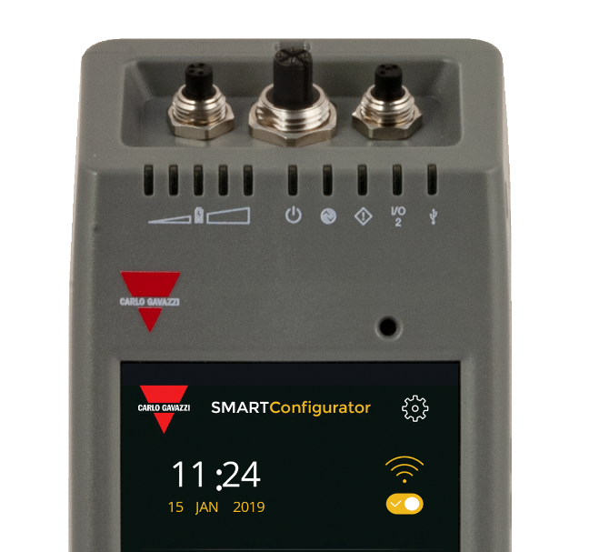
The product
LEDs
Battery status
Power
USB
IO-Link
SIO2
Error

Slide 15
The product
LEDs

Slide 16
The product
LEDs

Slide 17
The product
LEDs

Slide 18
The product
Connectors to connect Plug-version sensors
M8 4-wire
M8 3-wire
M12

Slide 19
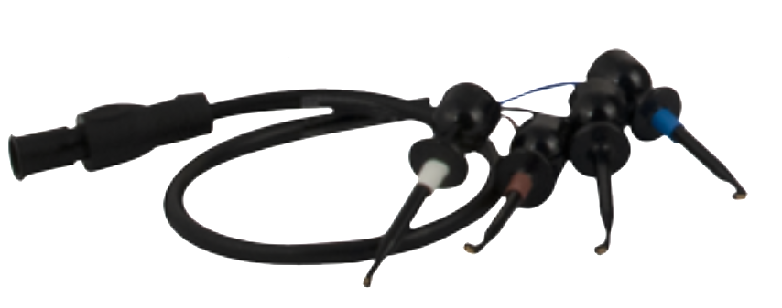
The product
Extension cable to connect cable-version sensors
0.5m M12 to 4 hooks, marked with different colors

Slide 20
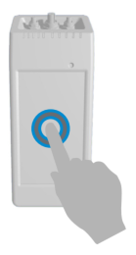
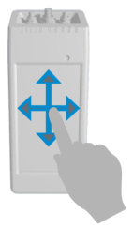
The product
Gestures
TOUCH
SWIPE

Slide 21
The product
Home page
Setting
Wi-Fi switch
Carlo Gavazzi App store
«Configure» App

Slide 22
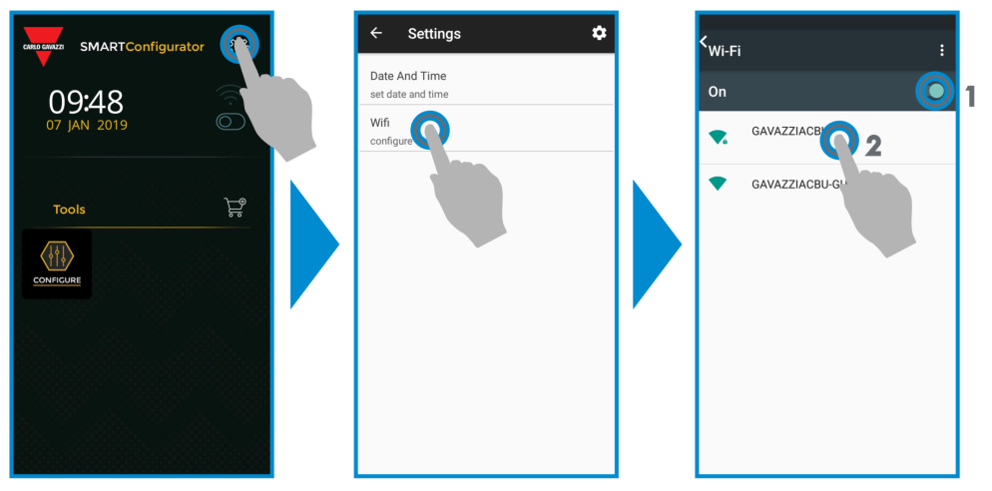
The product
Wi-Fi setting

Slide 23
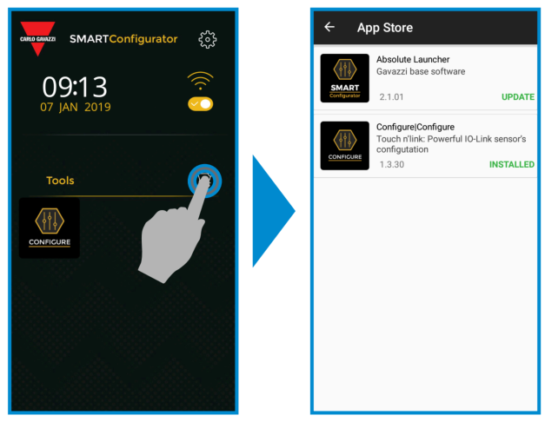
The product
Software update

Slide 24
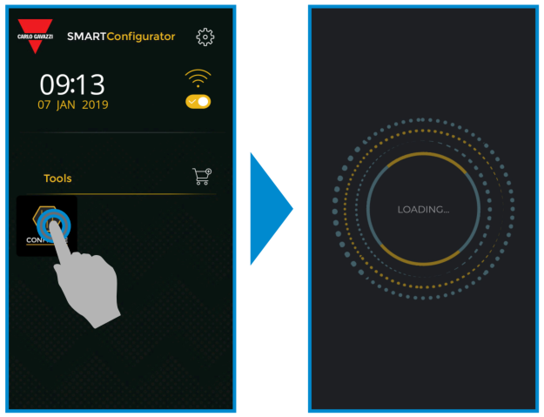
The product
Play the «Configure» APP

Slide 25
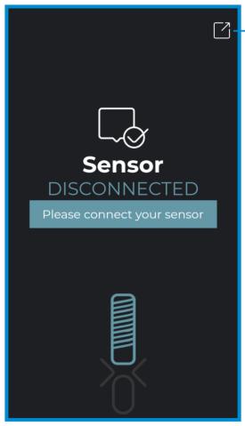
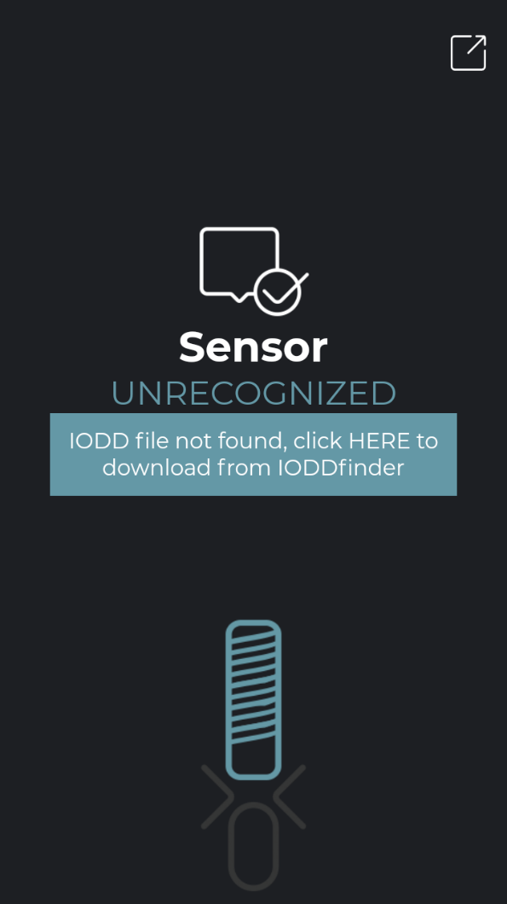
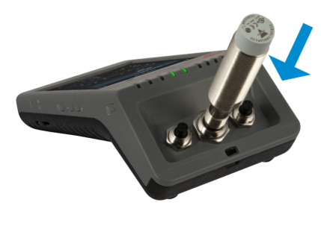
The product
Connect your sensor – IODD file not present on the device

Slide 26
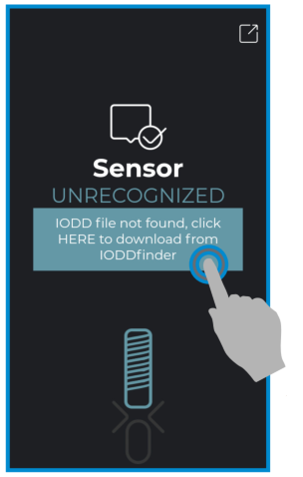
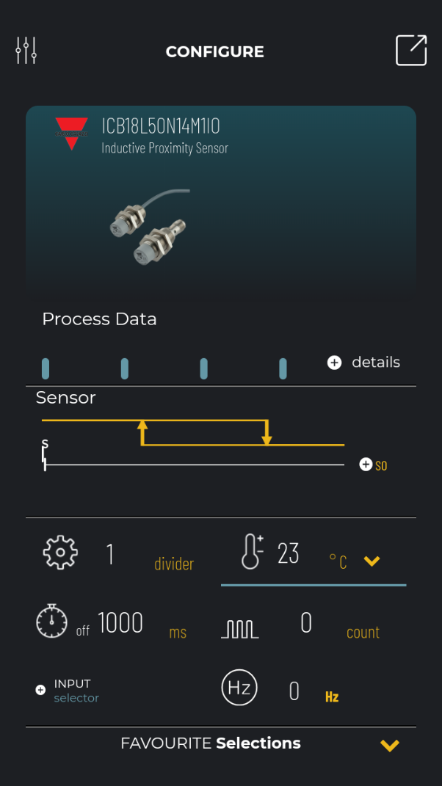
The product
Automatic download of IODD file and sensor configured

Slide 27
The product
«Configure» app homepage
Parameterization
Exit the App
Basic information of the sensor connected
Process DATA
Graphic of the set point
Main icons
Favourite parameters

Slide 28
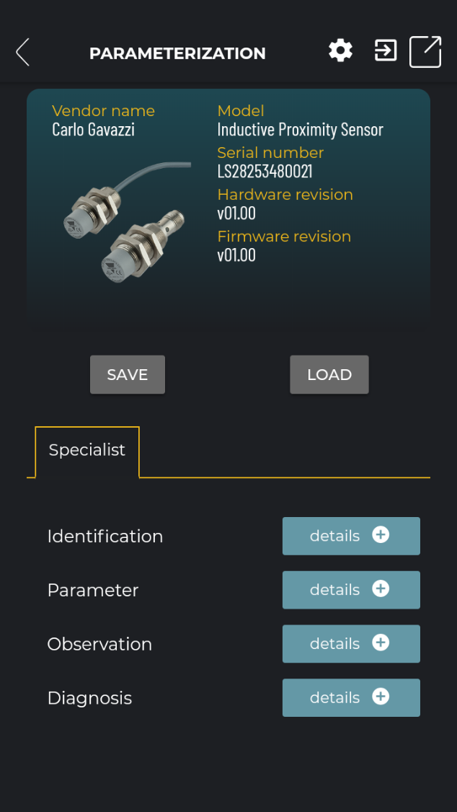
The product
Parameterization
Settings
Exit the App
Information on the sensor connected
Save config. file
Load config. file
User profile
Tab selection

Slide 29
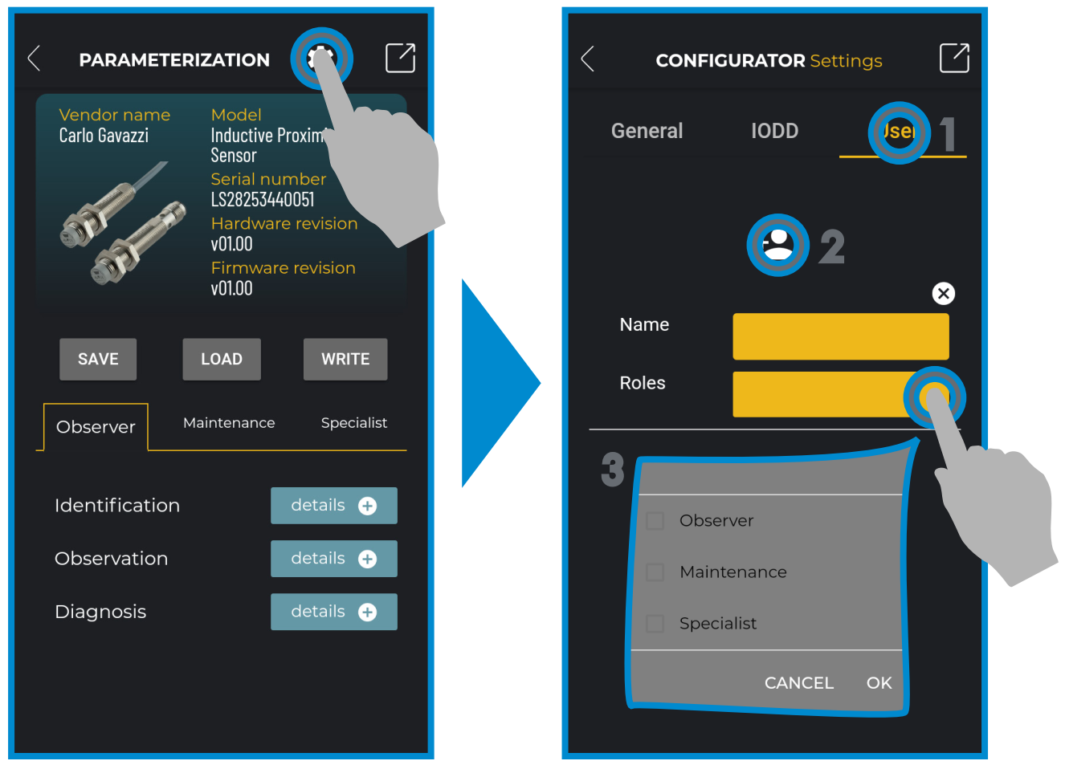
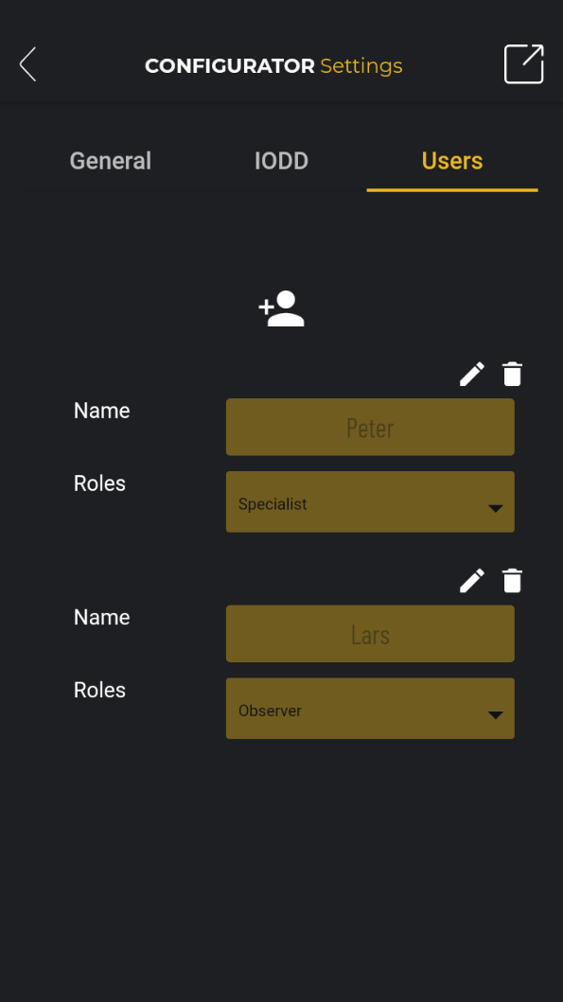
The product
Creation of a new user

Slide 30
The product
Access level to parameters for different user profiles

Slide 31
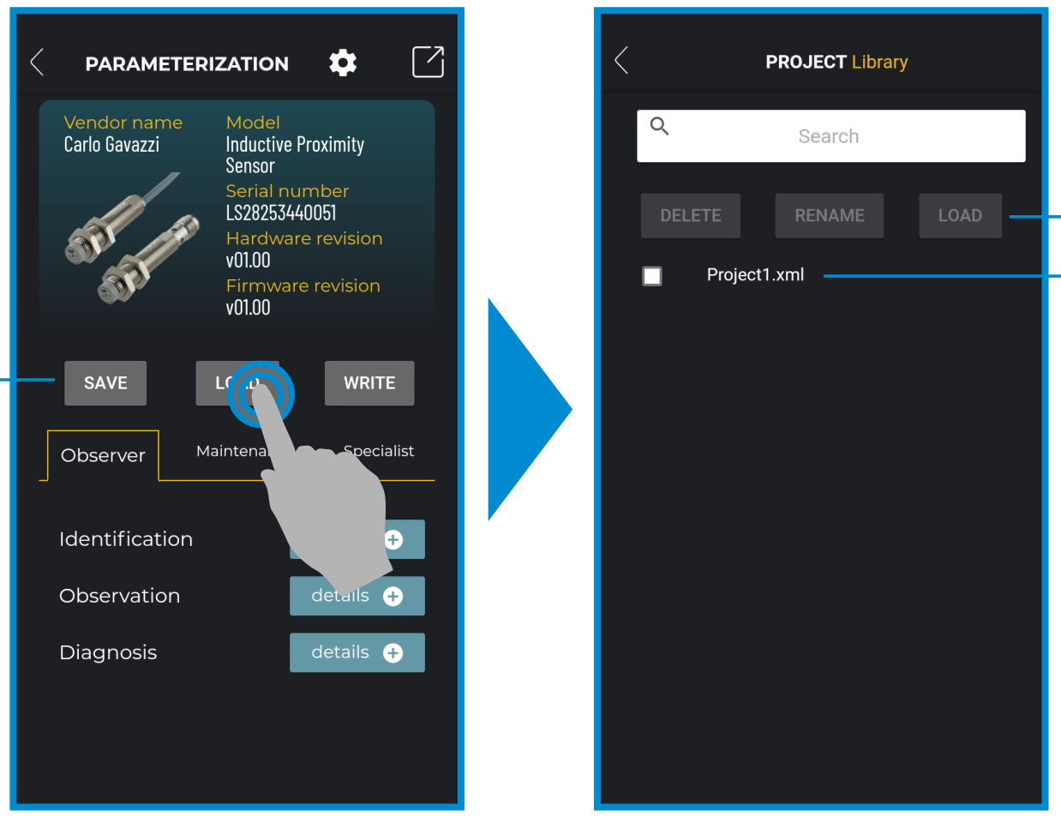
The product
Configuration file management: save, load and write
Delete, rename or load a project
List of project
Save, load and write a project

Slide 32
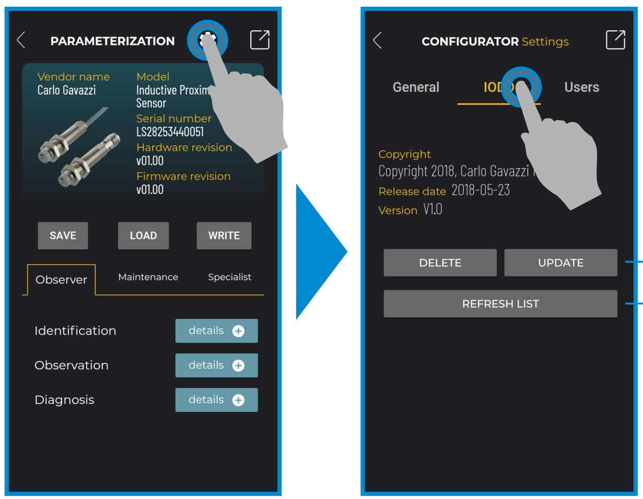
The product
IODD file
Delete or update the existing IODD files
Refresh the IODD index

Slide 33
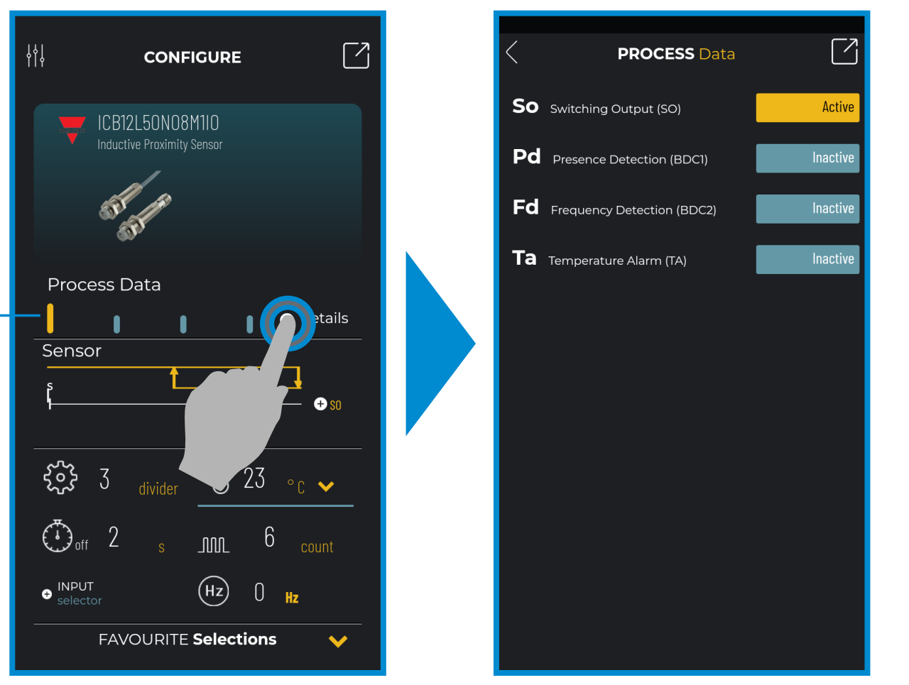
The product
Process data
Example of Switching Output active
Example of Switching Output active

Slide 34
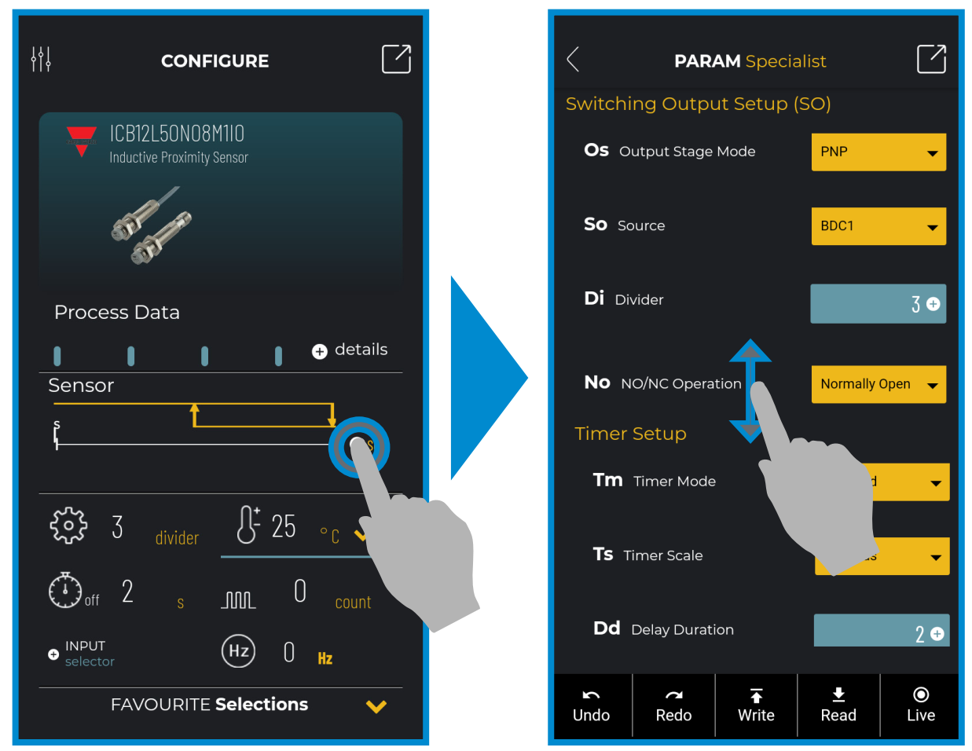
The product
Switching output setup
Select to change
Select to change
Command Icons

Slide 35
The product
Command icons
The changes are written into the sensor
Read the parameters from hthe sensor
1 step forward
In «Live mode» the changes are written automatically into the sensor
1 step back

Slide 36
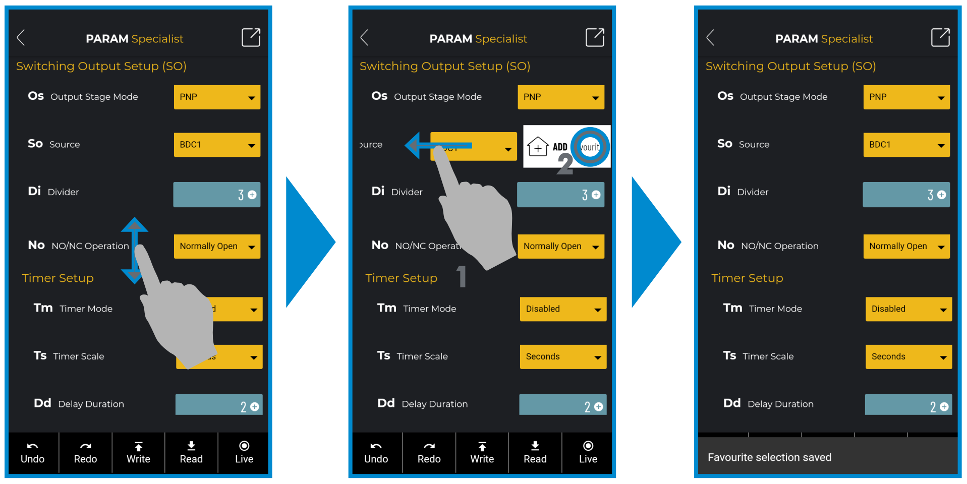
The product
Add a parameter to the favourite list

Slide 37
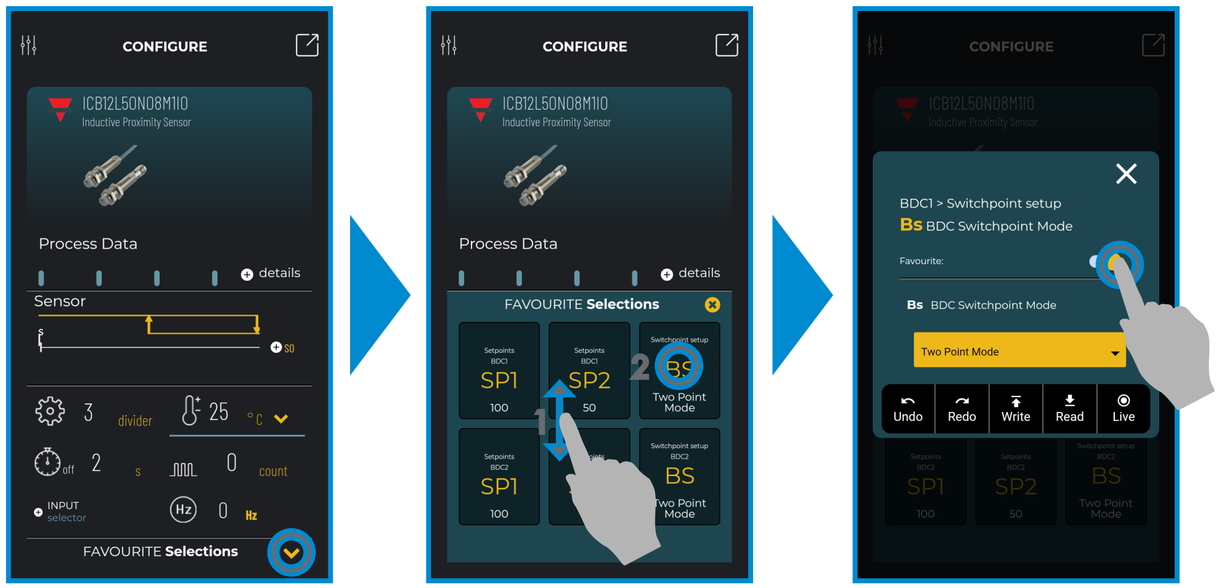
The product
Delete a parameter from the favourite list

Slide 38
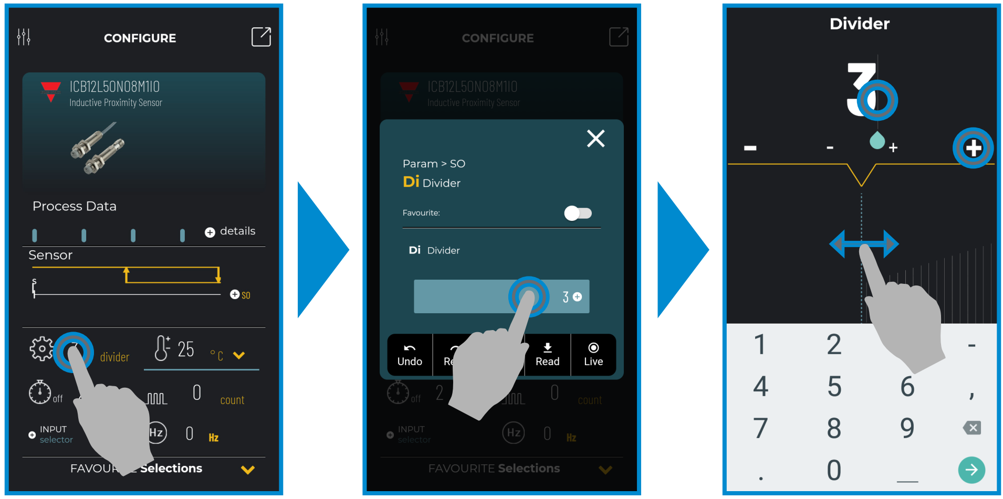
The product
Main icons: example with «Divider» function

Slide 39
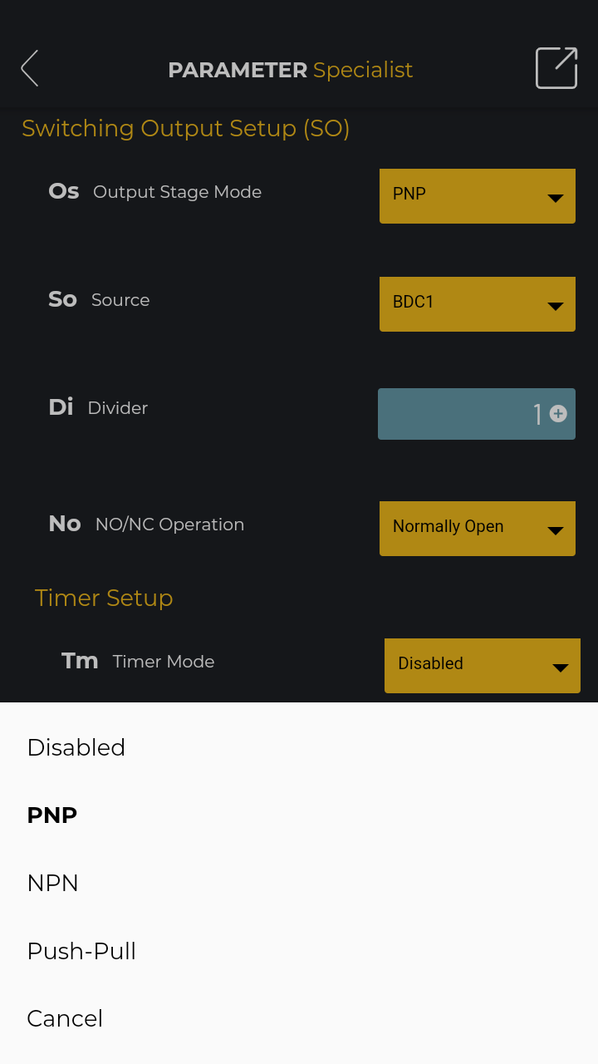
The product
Use case 1 - Parameterization of IO-Link sensors
1
Connect your sensor using one of the 3 connectors or with the extension cable
Scroll the parameters on the touch screen, chose the one you want to change and select the value among the multiple values proposed or by keying the value directly
2
3
Verify that the value is the one you need and write it into the sensor

Slide 40
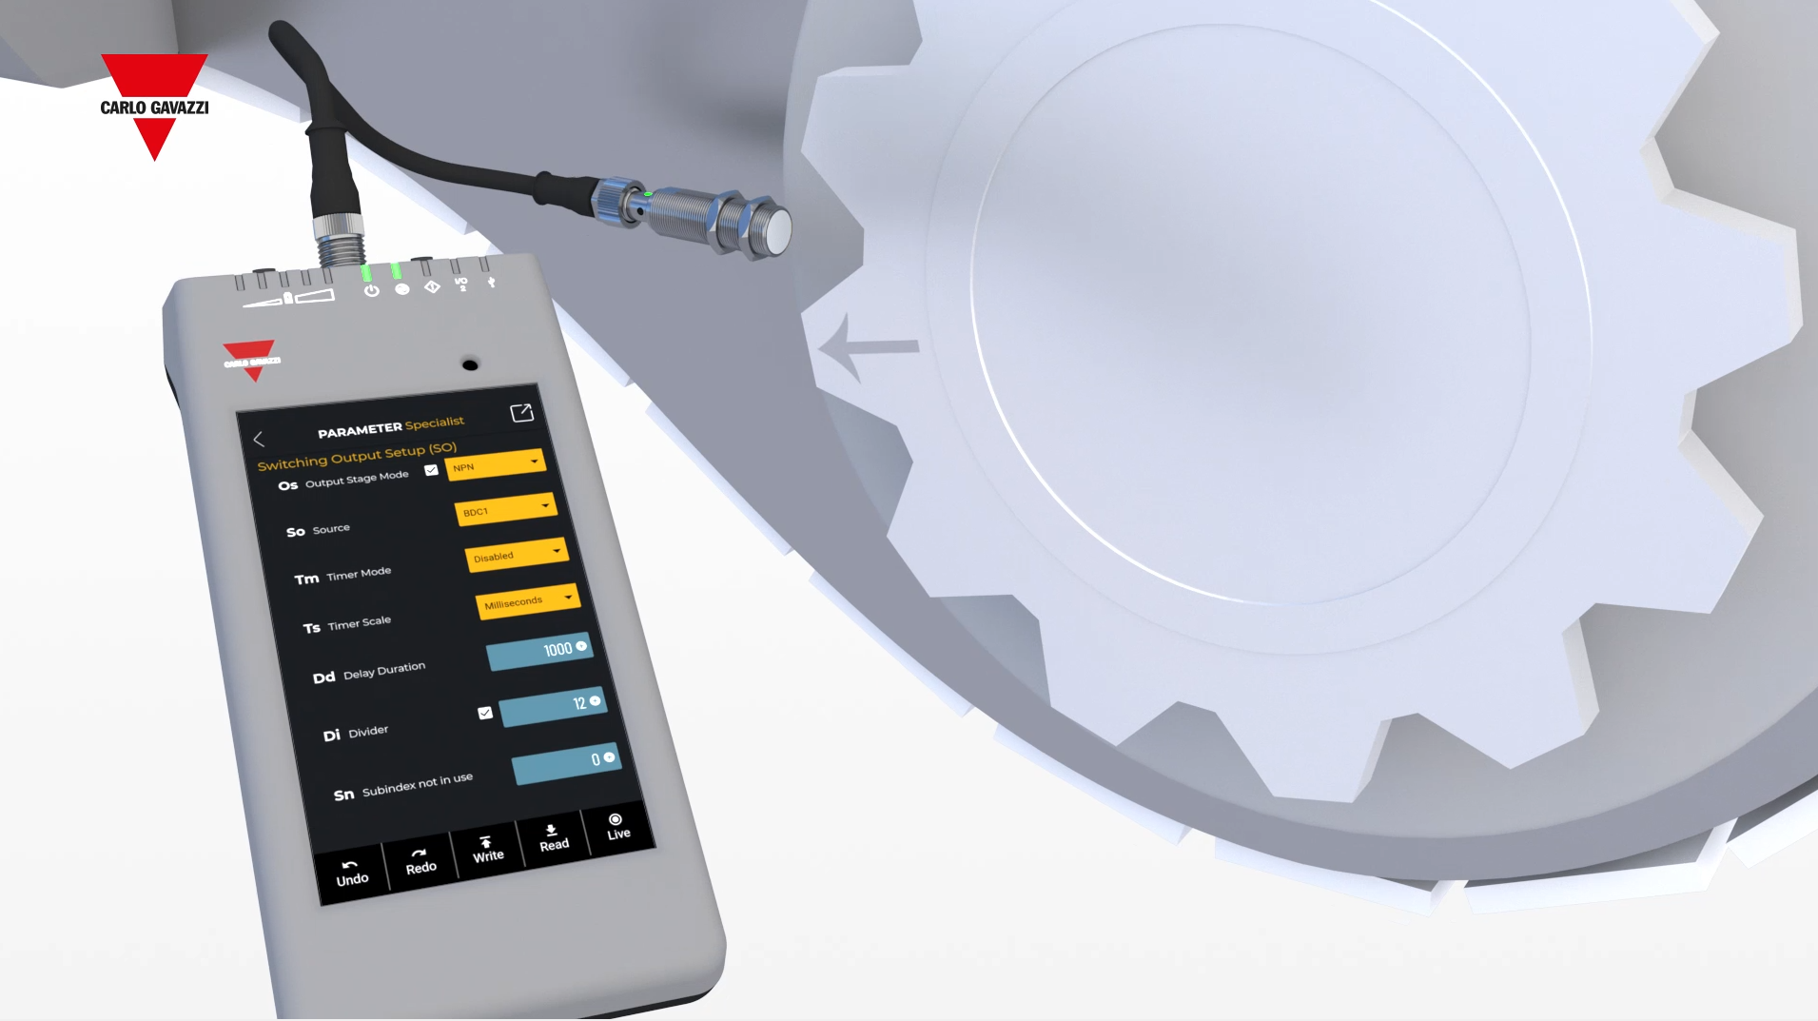
The product
Use case 2 – Initial commissioning of machines and plants
1
Connect the Smart Configurator directly to the sensor in the machine
Verify the behaviour of the sensor by reading the parameters and process data while the sensor is running
2
3
Adjust the sensor’s parameters to better fit the application

Slide 41
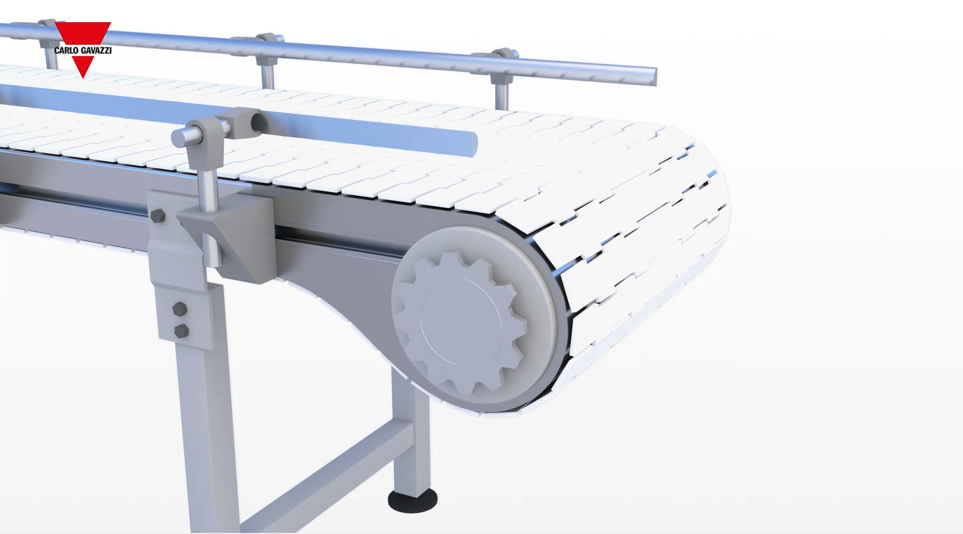
The product
Use case 3 – Sensor performance verification
1
Connect the Smart Configurator directly to the capacitive sensor located in the machine
Check the operating hours, number of detection and the quality of run value, to verify the actual sensing performance of your device
2
3
Adjust the sensor and fine tune it on the machine or replace it with a new one

Slide 42
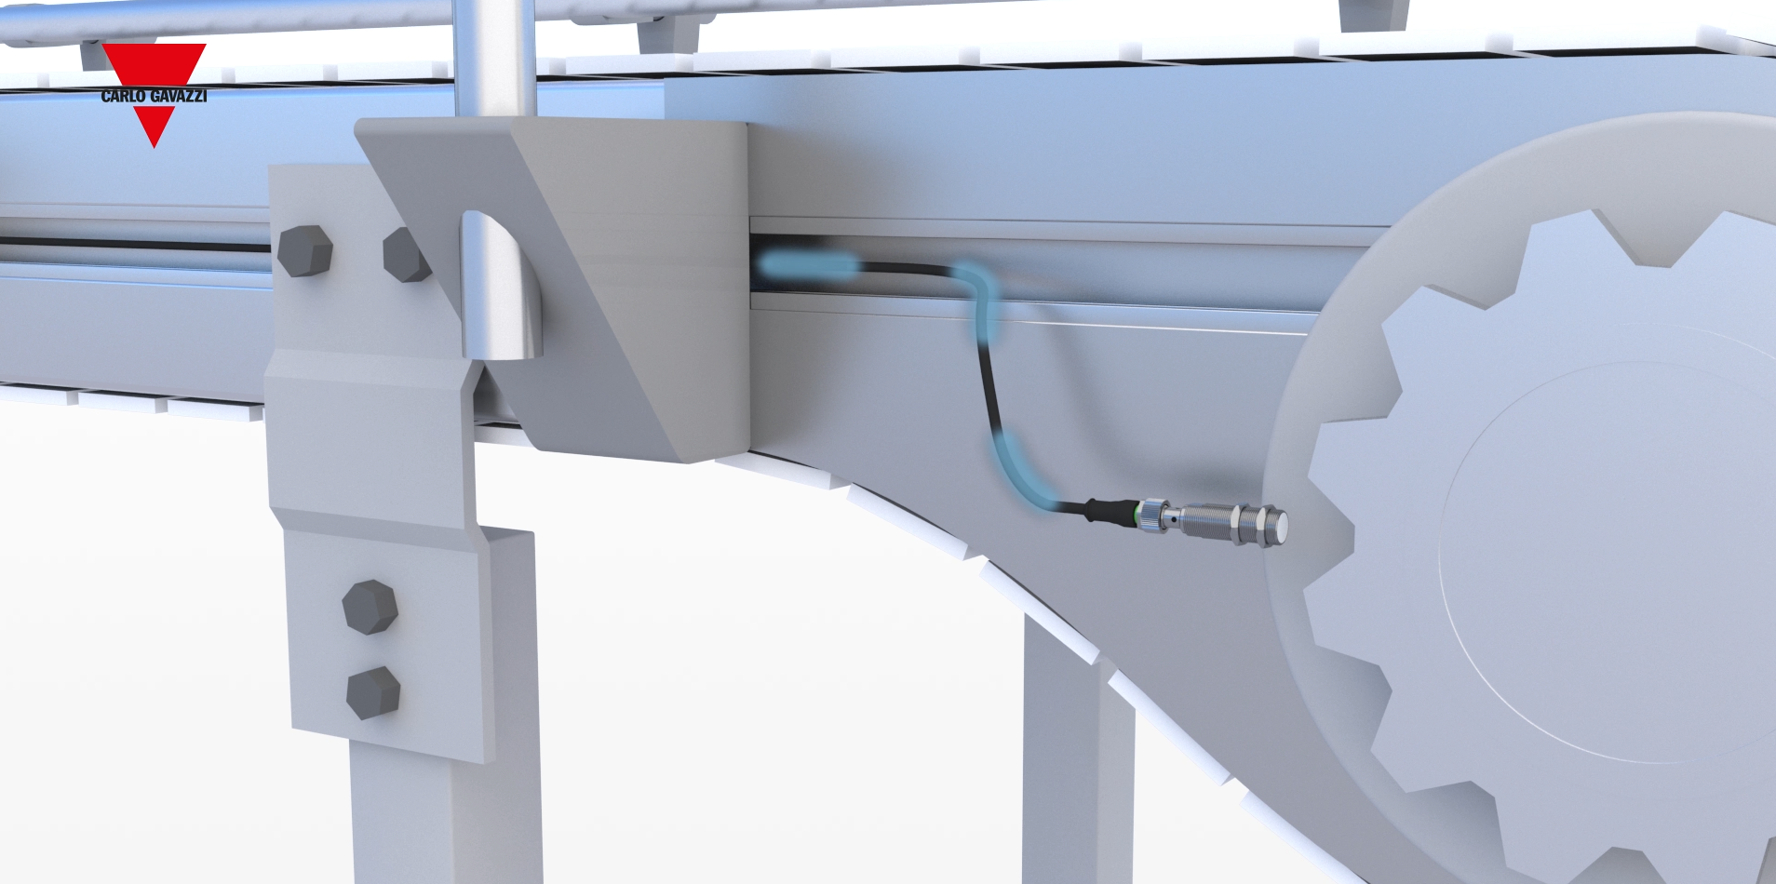
The product
Use case 4 – Status monitoring of IO-Link sensors
1
Connect the Smart Configurator directly to the sensor located in the machine
Easy access to the IO-Link sensor’s process and diagnostic data to monitor the status
2
3
Read the frequency, the temperature and check alarms and events

Slide 43
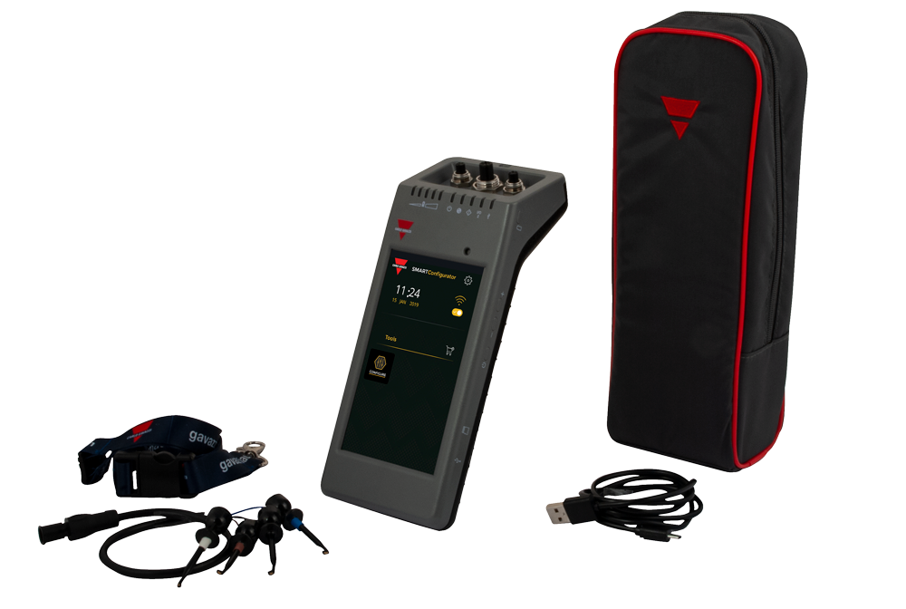
The product
Accessories
Lanyard
Protective holster
Extension cable
Micro USB cable

Slide 44
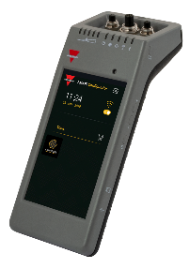
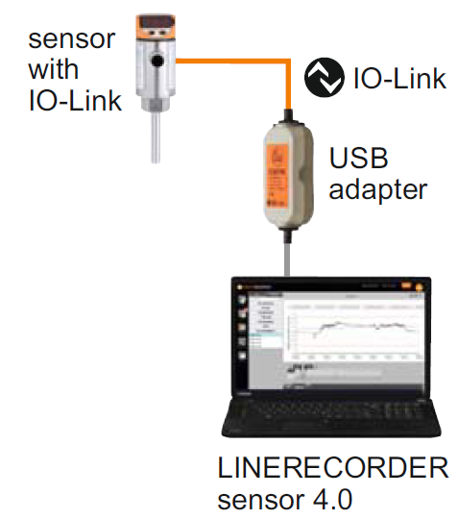
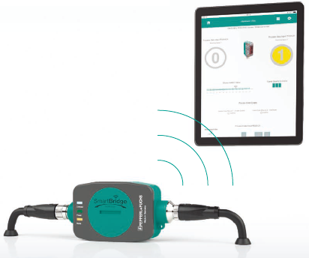
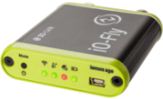
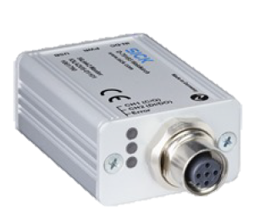
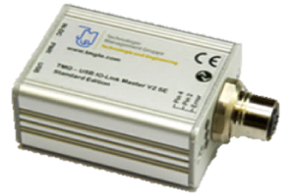
The product
Specifications | Carlo Gavazzi | IFM | P&F | Lemon Age | Sick | TMG
Model Name | SCTL55 | E30396 | Smart Bridge | IO-Fly | SiLink2Master | IO Link Device
Display | Yes | No | No | No | No | No
Platform | Stand alone | PC | Android, iOS | iOS | PC | PC
WiFi | Yes | No | No | Yes | No | No
Bluetooth | Future dev. | No | Yes | Yes | No | No
USB | Yes | Yes | No | Yes | Yes | Yes
Wired/Wireless | Wireless | Wired | Wireless | Wireless | Wired | Wired
Internal Memory | Yes | No | No | No | No | No
Expandable Memory | Yes | No | No | Yes | No | No
Self Powered | Yes | No | No | Yes | No | No
Software/App | Free | License | Free | Free | Free | Free
Wow Factor

Slide 45
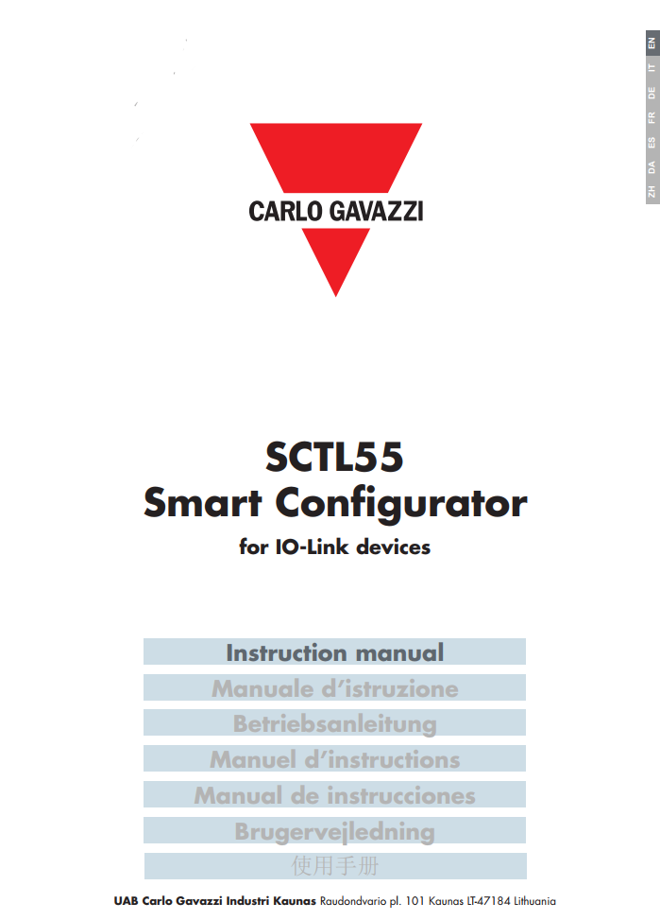
The market
Marketing Tools
Instruction manual
SCTL55 Smart Configurator
Available in: Chinese, Danish, English, French, German, Italian and Spanish

Slide 46
The market
Marketing Tools
Product Brochure
SCTL55 Smart Configurator
Available in: English

Slide 47
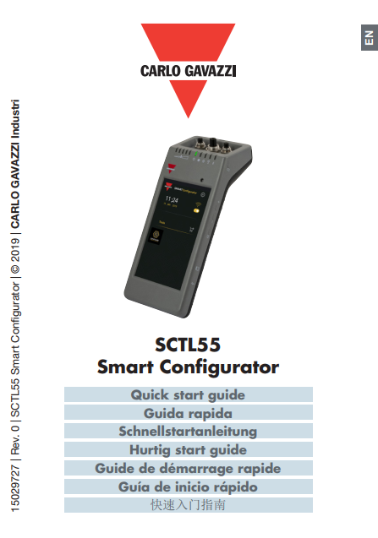
The market
Marketing Tools
Quick start guide
SCTL55 Smart Configurator
Multilanguage: Chinese, Danish, English, French, German, Italian and Spanish

Slide 48
The market
Certifications
General reference:
EN62368-1
Radio ETSI EN 300 328 v2.1.1
EMC CFR 47 Parts 15.107 & 15.109
Radio CFR 47 Part 15 Subpart C
Contains FCC ID: 2AH8Q-HT17

Slide 49
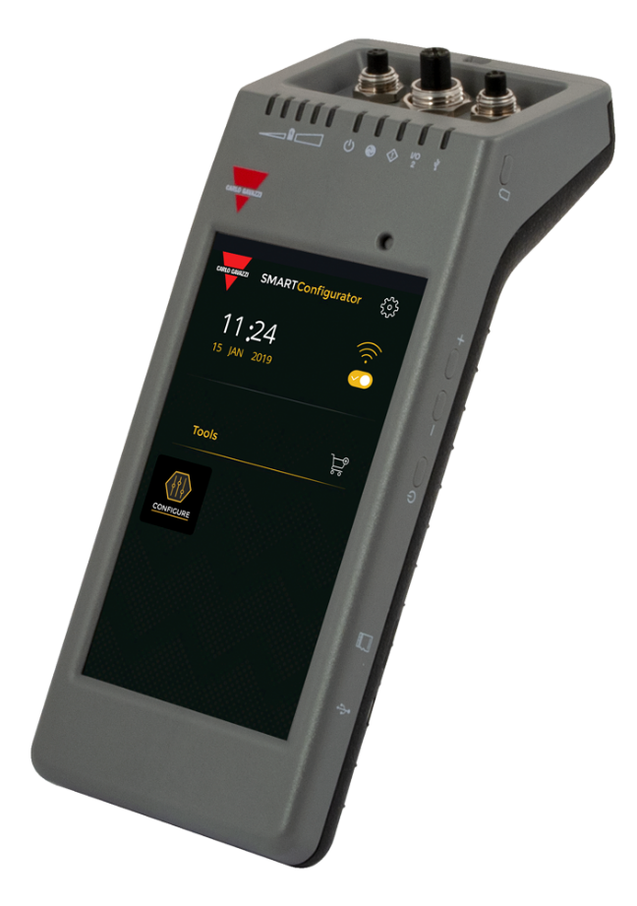
Conclusions
5.5” HD touch screen display
Easy and quick connection
Powerful diagnostic
IODD automatic download via Wi-Fi
Portability
High capacity battery
IO-Link

Slide 50
Thank you for your attention!

